Slide 1
Periodic Table and Atom Structure

Slide 2
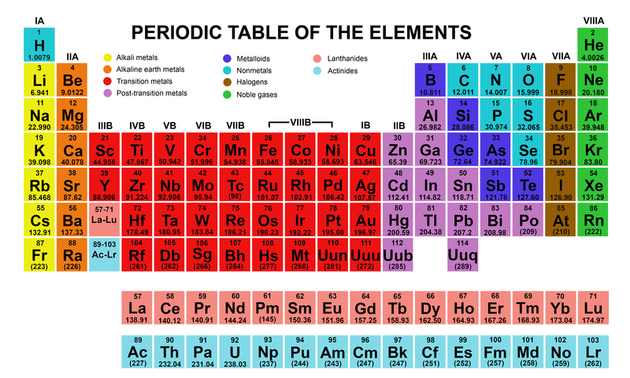

Slide 3
Periodic Table
Each row is called a period
Weight increases as you go across a period
Columns are called group or family
Columns have similar chemical properties
Alkali Metals
Alkaline Earth Metals
3. – 6. Post transition metals / Metalloids / Nonmetals
7. Halogens
8. Noble gases

Slide 4
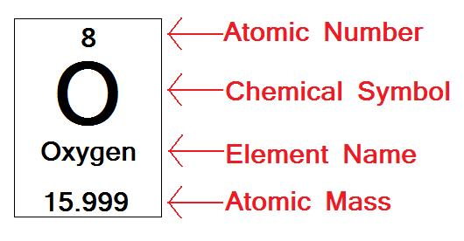

Slide 5
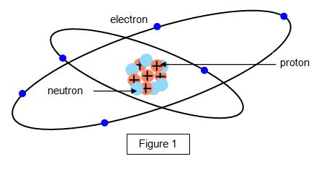
Atom Structure
Each atom is made up of protons, neutrons, and electrons
Protons and neutrons can be found in the nucleus of the atom
Electrons orbit around the nucleus

Slide 6
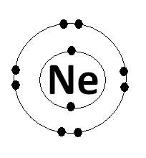
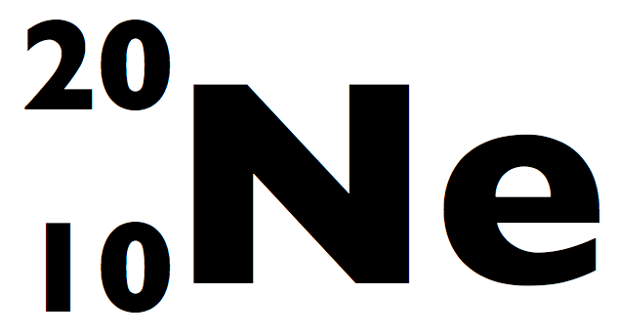
Ways to represent atoms
Up to eight electrons in the other orbitals
Atomic Mass
Up to two electrons in the first orbital
Atomic Number

Slide 7
Remember…
Atomic Mass = protons + neutrons
Atomic Number = # protons
# Protons = # electrons

