Slide 1
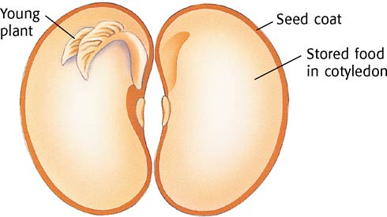
Lima Bean Diagram

