Slide 1
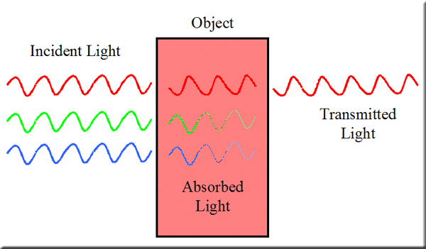
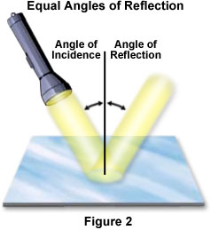
Light
Reflected light – light changes direction when bounced off a shiny smooth surface
Refracted light – light is bent when it passes from one substance to another (makes the object look bent)
Absorbed light – The light that an object takes in, not reflected or transmitted
Transmitted light – The light that is not absorbed by an object, what you can see

