Slide 1
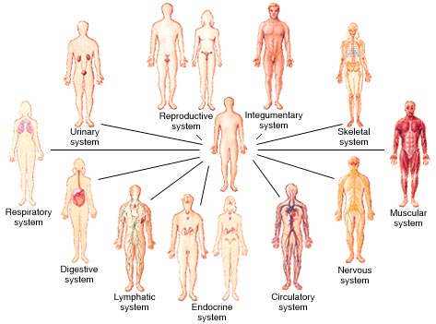
Human Body Systems

Slide 2
NGSS
MS – LS1-3 | Use argument supported by evidence for how the body is a system of interacting subsystems composed of groups of cells. [Clarification Statement: Emphasis is on the conceptual understanding that cells form tissues and tissues form organs specialized for particular body functions. Examples could include the interaction of subsystems within a system and the normal functioning of those systems.] [Assessment Boundary: Assessment does not include the mechanism of one body system independent of others. Assessment is limited to the circulatory, excretory, digestive, respiratory, muscular, and nervous systems.]

Slide 3
Human Body Preview
http://video.nationalgeographic.com/video/101-videos/human-body-sci

Slide 4
Human Body Intro
http://www.ck12.org/life-science/Organization-of-the-Human-Body-in-Life-Science/lecture/Human-Body-Plan/
Watch the video and answer the following questions on a scrap sheet of paper.
What kind of symmetry does the human body plan show? Explain what this means.
How does this symmetry extend to our senses?
How much of our body is made of muscle? What does this muscle do?
How are oxygen and nutrients delivered to the cells of the body?
What controls all the activity on the body? How much energy does this organ use?

Slide 5
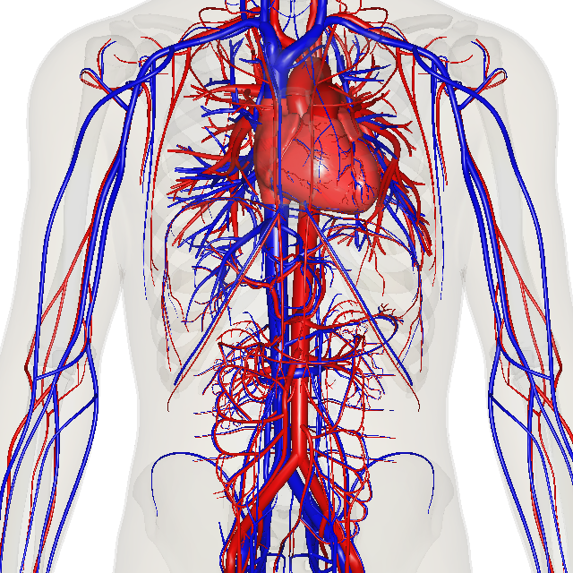
Circulatory (Cardiovascular) System
Function: Transports oxygen and nutrients to the cells of the body
Structure: heart, blood vessels, blood, lungs

Slide 6
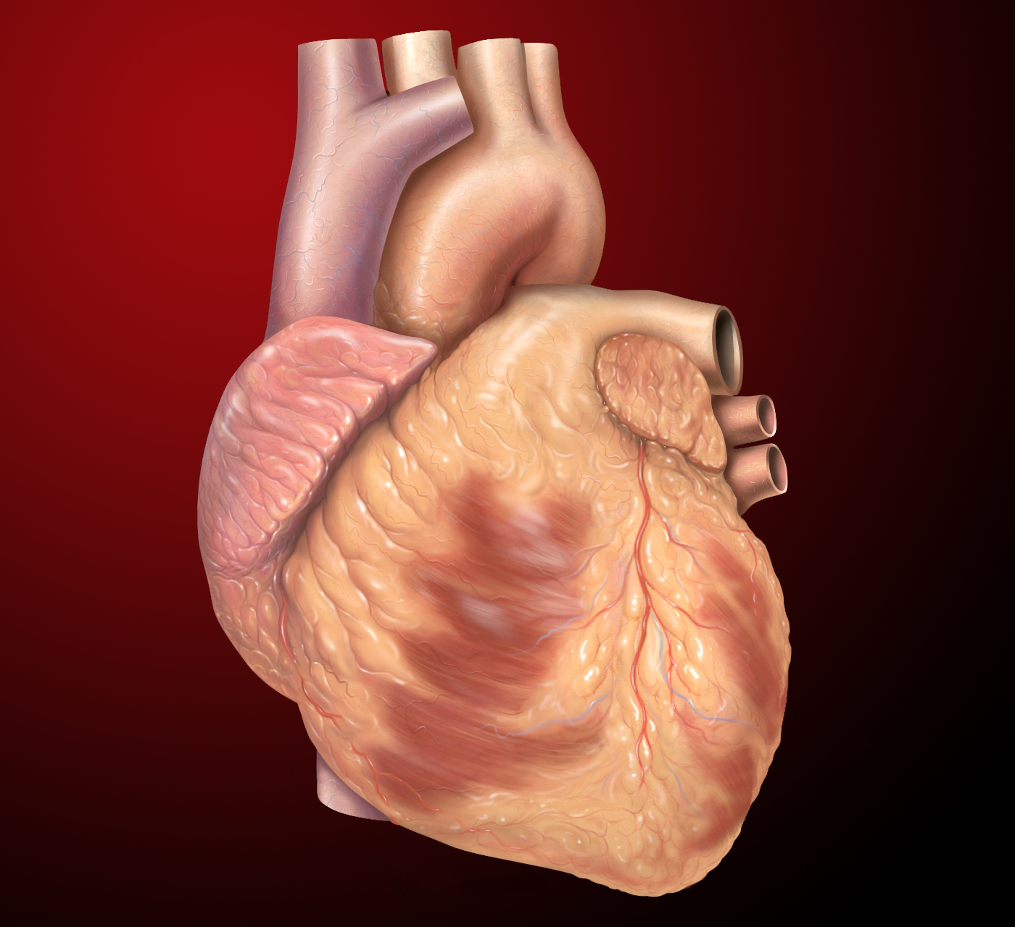
How the heart works:
How the heart works:
https://www.youtube.com/watch?v=s2OIaXZZI0w

Slide 7
Circulatory Study Jam
http://studyjams.scholastic.com/studyjams/jams/science/human-body/circulatory-system.htm

Slide 8
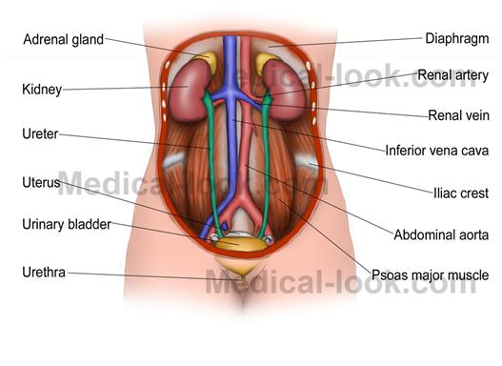
Excretory System
Function: Removes wastes produced by the cells
Structure: Skin, lungs, kidneys, ureters, bladder, and urethra

Slide 9
Excretory Video & Quiz
http://kidshealth.org/kid/htbw/USmovie.html

Slide 10
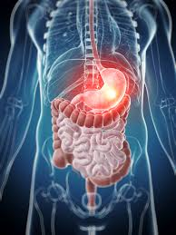
Digestive System
Function: Breaks down food and absorbs nutrients
Structure: Mouth, esophagus, stomach, small and large intestines

Slide 11
Digestive System Video
https://www.youtube.com/watch?v=_QYwscALNng

Slide 12
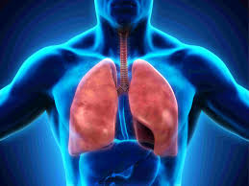
Respiratory System
Function: Takes in oxygen and eliminates carbon dioxide.
Structure: Trachea, lungs, bronchi, and alveoli

Slide 13
Respiratory Video
https://www.youtube.com/watch?v=hc1YtXc_84A

Slide 14
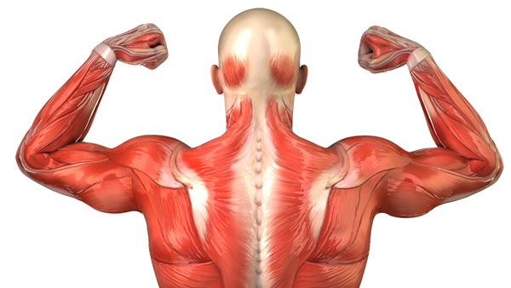
Muscular System
Function: Enables movement of the body and internal organs.
Structure: Muscles, tendons

Slide 15
Muscular Video
https://www.youtube.com/watch?v=jqy0i1KXUO4

Slide 16
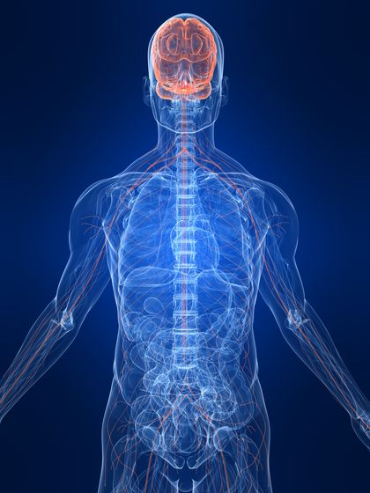
Nervous System
Function: Controlling the body and communication among its parts
Structure: brain, spinal cord, nerves

Slide 17
Nervous System Study Jam
http://studyjams.scholastic.com/studyjams/jams/science/human-body/nervous-system.htm

Slide 18
All Systems Go Interactive
Review the body systems using the interactive game.
http://sciencenetlinks.com/interactives/systems.html

