Slide 1
Heat Transfer
Engineering Design Unit

Slide 2
Day 1

Slide 3
Zika Virus
What is it?

Slide 4
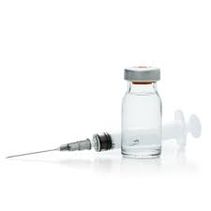
Engineering problem? Vaccine Handling and Storage
Receive vaccine shipments-
Open package immediately
Maintain the cold chain!
Know where to put which vaccines
Refrigerator or freezer?
Monitor temperatures
Report refrigerator power failure and other problems
Transport vaccines properly

Slide 5
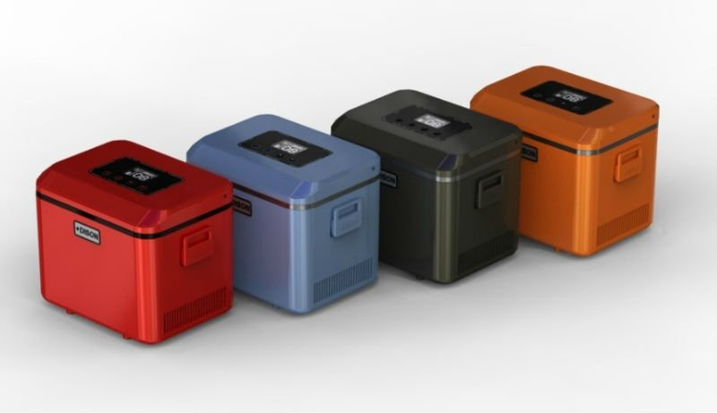
How Can we help?
If a new vaccine is created, a container will be needed to house the vaccine under the appropriate conditions as it travels to South America and to locations where it is needed.
What can we keep in mind?

Slide 6
Insulation Problem
You are going on a field trip and must pack a lunch to take with you. You put a can of cold soda in your lunch bag in the morning, but when you open your lunch later that day the soda was warm! What happen?

Slide 7
Soda Can Insulation
Material | Temperature of soda after Refrigeration (⁰C) | Temperature of soda after 1 hour of insulation (⁰C)
Wool sock
Paper Towel
Aluminum
Plastic Wrap
Cotton sock
Nothing

Slide 8
Heat – the transfer of thermal energy
Temperature – an indication of the amount of energy
Insulator – material that reduces the rate of heat transfer

Slide 9
Conduction is the way thermal energy transfer from one substance to another by direct contact
Radiation is the transfer of energy in the form of electromagnetic waves
Convection occurs when moving fluids (gases and liquids) rise and fall due to differences in density.

Slide 10
Design challenge
Design a container to hold a vaccine. The container must meet the following requirements or the vaccine will go bad:
Temperature must remain between 2-8 degrees Celsius and must not freeze.
During transport, any ice packs used must not touch the container of inactivated vaccine vials directly.
The vaccines must not shift during transport.
You must leave a small opening just large enough for a thermometer to be inserted to monitor the vaccines temperature at all times.
You must keep track of heat gained or lost.

Slide 11
Day 3
Storybook!
Team Name
Mini – lessons (stations)
Initial design
Data from first test
Changes to design
Data from second test
Graph of all tests
Calculated heat loss of gain
Cost to make your container

Slide 12
Cost of materials
Large foam cup………………….………$0.50
Small foam cup………………………....$0.25
Paper cup…………………….…….…….….$0.40
Tape …………………………….………….…… $0.10/ ft
Aluminum foil …………………..…… $0.30/ ft²
Plastic wrap ……………….….……..$0.02 / ft²
You may add additional materials, but must include the cost.

Slide 13
Time restraints
Normally, a container would take at least 6 days to reach Liberia.
Due to time restraints, the temperature of your container must be recorded for at least 30 minutes.
A data table must be constructed by each group member to keep track of your results.
A graph of your results must be completed.

