Slide 1
Data Tables vs. Graphs

Slide 2
Data Tables
Tables are
Organized in columns and rows
Used to organize exact amounts of data and display information
Show numerical specifics rather than visual
Hard to read and see trends

Slide 3
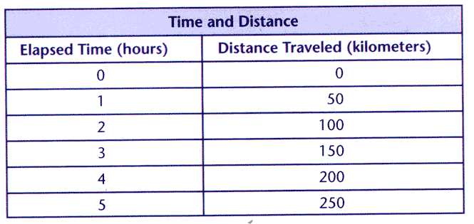
Example

Slide 4
DATA TABLES
Title | _______/2
Headings | _______/2
Correct Data | _______/2
Units | _______/2
Rulers/Straight Lines | _______/2
TOTAL | ______/10 PTS.

Slide 5
Create a Data Table
Adidas – 25, Nike – 32, Reebok – 10, Asics – 18, Other - 15

Slide 6
Graphs
Line Graphs
Look at trends
Are used when your data is all numerical
Change over time
Bar Graphs
Compare data and trends
Are used when your data is half numerical
Amount of something

Slide 7
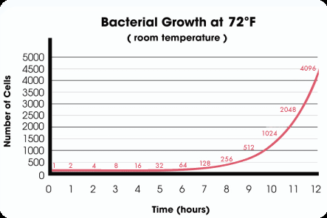
Example

Slide 8
GRAPH
Title | _______/1
Title describes what graph is about | _______/1
Appropriate graph type | _______/1
X-axis labeled with units | _______/1
Y-axis labeled with units | _______/1
X-axis scale is labeled | _______/1
Y-axis scale is labeled | _______/1
Graph uses 80% or more of paper | _______/1
Trendline/Line of best fit (if applicable) | _______/1
Graph is accurate and matches data table | _______/1
TOTAL | ______/10 PTS.

Slide 9
Use The Data Table and Graph

Slide 10
Create Data Table and Graph
Plant growth over 7 days:
day one – 1cm, day two – 3cm, day three – 4cm, day four – 6cm, day five – 9cm, day six – 12cm, day seven – 15 cm
2. Fatty Acid Content of Food in %:
Swiss cheese – 27.6, turkey – 2.6, peanuts – 49.7, eggs – 11.3, olive oil – 100.0, shrimp – 1.2, butter – 80.1

