Slide 1
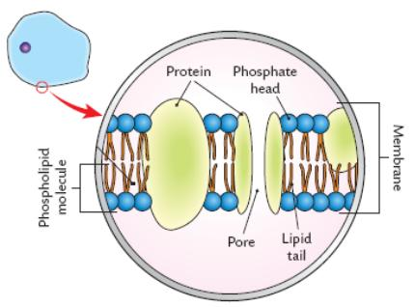
Cell Membrane

Slide 2
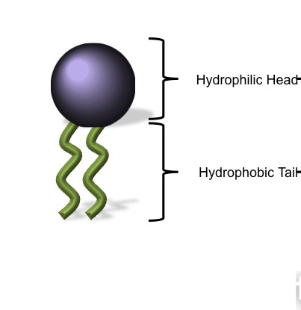
Phospholipid Molecule
Water loving
Water Hating

Slide 3
Transport
Active Transport – needs energy
Passive Transport – no energy required

