Slide 1
Introduction to Bacteria
The Good, the Bad and the Ugly…

Slide 2
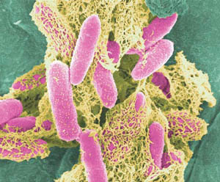
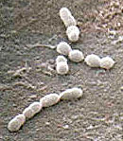
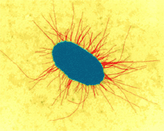
What are bacteria?
Unicellular (single-celled) organisms
Prokaryotic (no nucleus)
Microscopic (very small)
Can be found on most materials and surfaces
Billions on and in your
body right now
E. Coli O157:H7 can make you very sick.
Streptococcus can cause strep throat.
This bacteria helps you digest food.

Slide 3
What do they look like?
Three basic shapes:
Bacilli (rod-shaped)
Cocci (round shaped)
Spiral shaped
Some exist as single cells, others as cluster together
Bacilli
Cocci
Cluster of cocci
Spiral
USDA NIFSI Food Safety in the Classroom©
University of Tennessee, Knoxville 2006

Slide 4
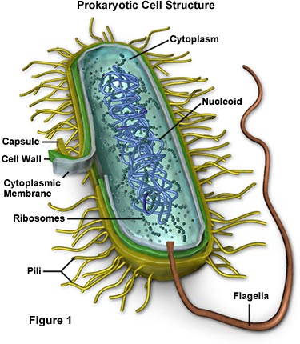
Bacteria are ALIVE!
What does it mean to be alive?
They reproduce (make an exact copy of themselves in a process called binary fission)
They need to eat
USDA NIFSI Food Safety in the Classroom©
University of Tennessee, Knoxville 2006

Slide 5
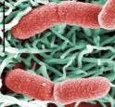
How do bacteria eat?
Some make their own food from sunlight—like plants
Some are scavengers
Share the environment around them
Example: The bacteria in your stomach are now eating what you ate for breakfast
Some are warriors (pathogens)
They attack other living things
Example: The bacteria on your face can attack skin causing infection and acne
Photosynthetic bacteria
Harmless bacteria on the stomach lining
E. Coli O157:H7
is a pathogen
USDA NIFSI Food Safety in the Classroom©
University of Tennessee, Knoxville 2006

Slide 6
What is a pathogen?
Bacteria that make you sick
How do they make you sick?
They produce poisons (toxins) that result in fever, headache, vomiting, and diarrhea which destroy body tissues.
USDA NIFSI Food Safety in the Classroom©
University of Tennessee, Knoxville 2006

Slide 7
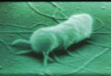
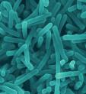
What are some common pathogens?
E. coli O157:H7
Pathogenic E. coli
Found in ground beef, contaminated fruits and vegetables
Salmonella
Found in raw meats, poultry, eggs, sprouts, fruit and vegetables
Listeria
Found in deli foods, lunch meats, smoked fish and vegetables
Salmonella
USDA NIFSI Food Safety in the Classroom©
University of Tennessee, Knoxville 2006
Listeria

Slide 8
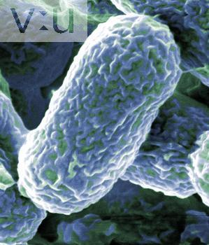
Examples of Pathogens
Salmonella
E. coli O157:H7
What shape are these bacteria? Cocci, bacilli, or spiral?
Staphylococcus aureus
Campylobacter jejuni
USDA NIFSI Food Safety in the Classroom©
University of Tennessee, Knoxville 2006

Slide 9
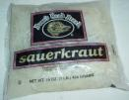
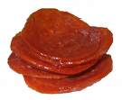
Are all bacteria pathogens?
No, most are harmless
Some are even helpful
Examples of helpful bacteria:
Lactobacillus: makes cheese, yogurt, & buttermilk and produces vitamins in your intestine
Leuconostoc: makes pickles & sauerkraut
Pediococcus: makes pepperoni, salami, & summer sausage
USDA NIFSI Food Safety in the Classroom©
University of Tennessee, Knoxville 2006

Slide 10
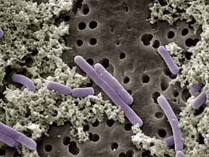
A Closer Look – Helpful Bacteria
www.bioweb.usu.edu
Pediococcus - used in production of fermented meats
Lactobacillus casei – found in human intestines and mouth to improve digestion
Leuconostoc cremoris – used in the production of buttermilk and sour cream
Lactobacillus bulgaricus – used in the production of yogurt
USDA NIFSI Food Safety in the Classroom©
University of Tennessee, Knoxville 2006

Slide 11
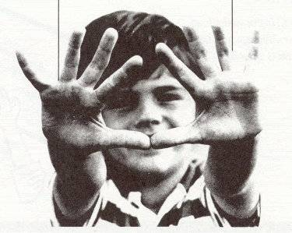
How can I avoid pathogens?
Wash your hands often so you won’t transfer bacteria to your mouth or food
Warm water with soap for 20 seconds, rub hard between fingers and nails
USDA NIFSI Food Safety in the Classroom©
University of Tennessee, Knoxville 2006

Slide 12
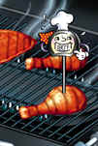
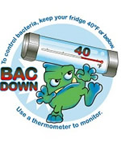
How can I avoid pathogens?
Cook food thoroughly to kill any pathogens that may be in your food
Store food properly to limit pathogen growth
Cold temperatures (40°F)
USDA NIFSI Food Safety in the Classroom©
University of Tennessee, Knoxville 2006

Slide 13
What environmental conditions result in the growth of bacteria?
Moisture
Nooks and Crannies
Nutrients

Slide 14
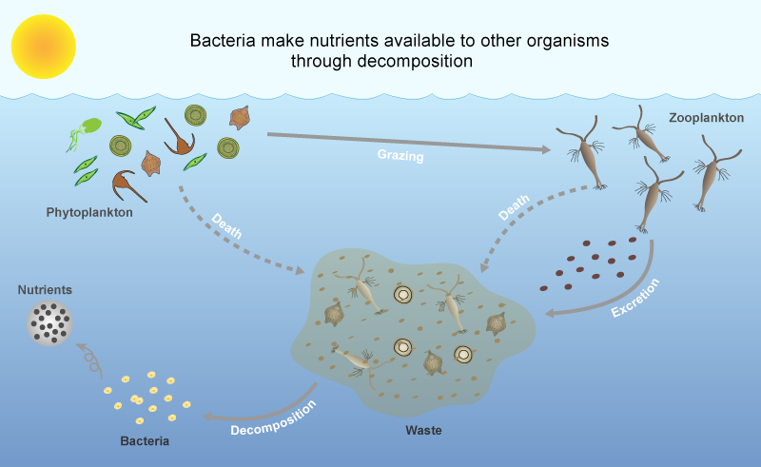
Why are bacteria essential to life?
Bacteria recycle nutrients through decomposition so other organisms can use them again.

Slide 15
Review
Bacteria are living organisms
Most are harmless
A few are pathogens that make you sick
You can reduce the risk of getting sick by washing your hands and handling food properly.
USDA NIFSI Food Safety in the Classroom©
University of Tennessee, Knoxville 2006

